Slide 1
Chapter 4 Sub-programs

Slide 2
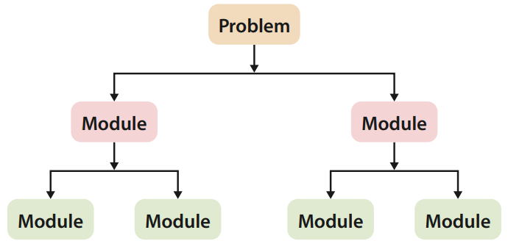
Sub-programs
4.1
As mentioned in previous parts, when we break down a complicated problem into several smaller and manageable sub-problems (also known as modules).

Slide 3
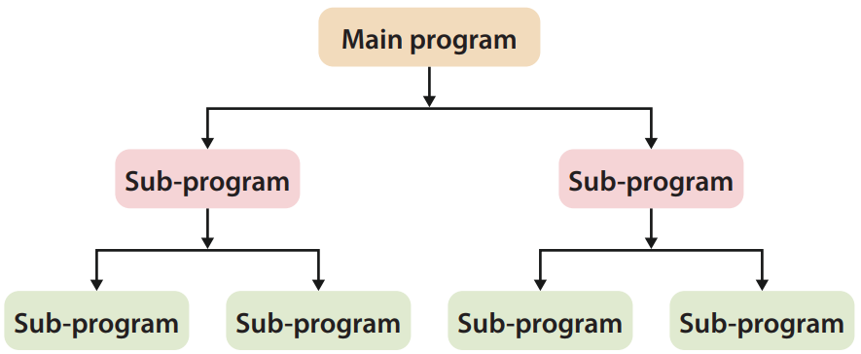
Sub-programs
4.1
Similarly, when designing algorithms or writing programs, people often use a modularised design intentionally.
These modules in a program are called sub-programs (also called functions in Python). They can be used individually and repeatedly, and each of them represents multiple lines of code.

Slide 4
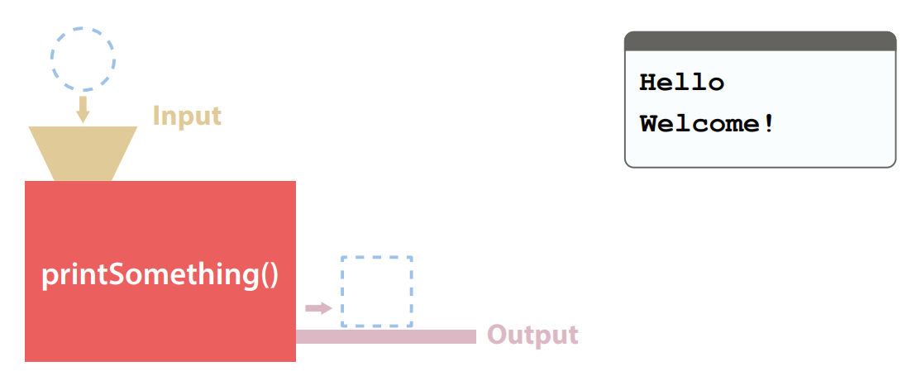
Types of sub-programs
B
Some sub-programs have neither input parameters nor return values. They usually execute default code and are mainly for printing some information in the shell.

Slide 5
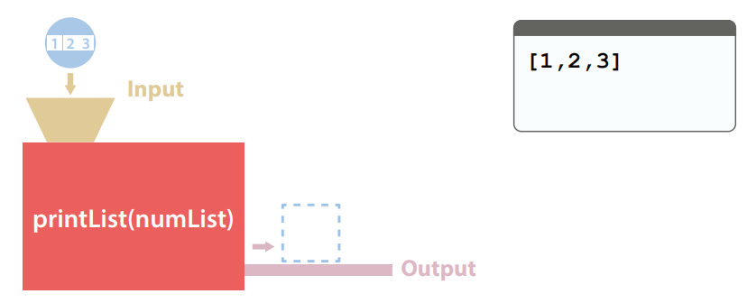
Types of sub-programs
B
Some sub-programs have input parameters but no return values. They perform operations on parameters, yet do not return the results as return values.

Slide 6
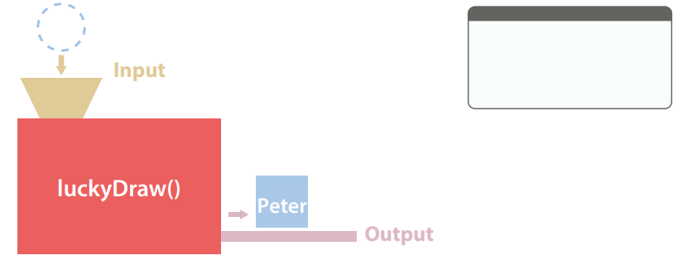
Types of sub-programs
B
This type of sub-programs have return values even though there are no input parameters. They can produce return values without relying on parameters.
Some of these sub-programs directly use variables in the program to perform operations instead of obtaining input values in the form of parameters.

Slide 7
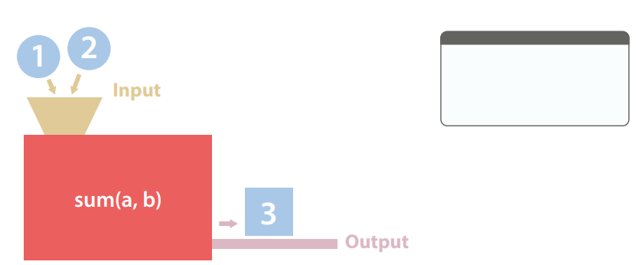
Types of sub-programs
B
This type of sub-programs have input parameters and return values.

Slide 8
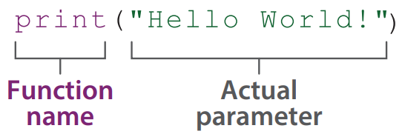
Calling Sub-programs
4.2
In Python programs, we call a function by writing the function name and the required actual parameter.

Slide 9
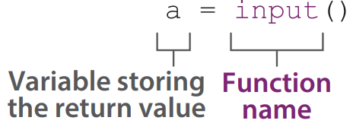
Calling Sub-programs
4.2
If this function has a return value, a variable can be used to store the return value.

Slide 10
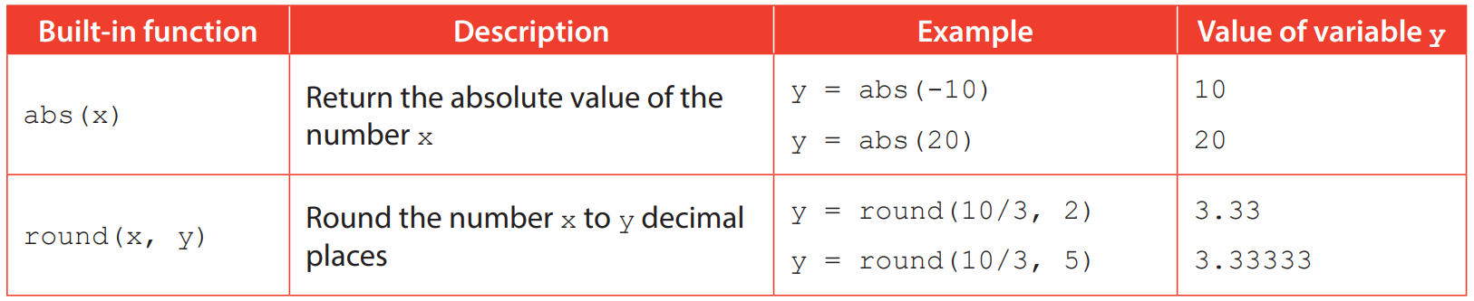
Built-in functions
A
Python has many built-in functions, providing users with frequently used functions. print(), input(), type(), int(), float() and str() are examples of Python built-in functions.
The following are some more examples of common built-in functions:

Slide 11
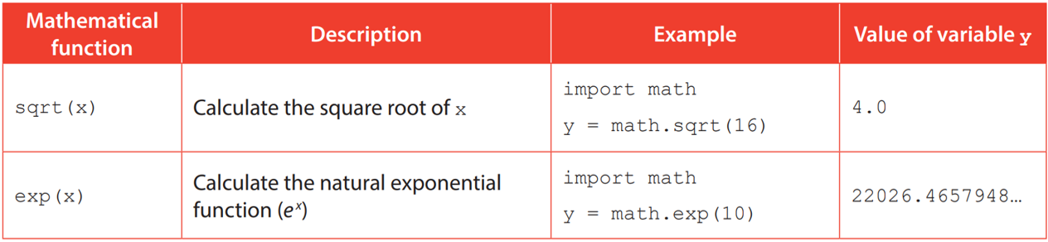
Mathematical functions
B
To use functions other than those provided by the built-in functions, we need to import a library. A library is formed by many functions with related uses.
Below are some mathematical functions in the “math” library:

Slide 12
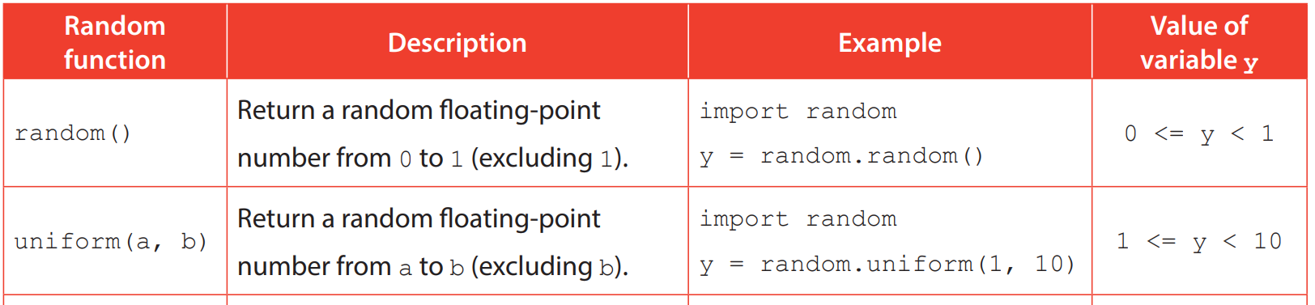
Random functions
C
Randomness is a common element in lucky draws and games, which makes the result difficult to predict and brings surprise to the participants. Below are some random functions in the “random” library:

Slide 13
4.1
Complete Checkpoint 4.1 on P. 111 of your textbook.
1. (a) 74.8
(b) 2
2. (a) 5
(b) 3

Slide 14
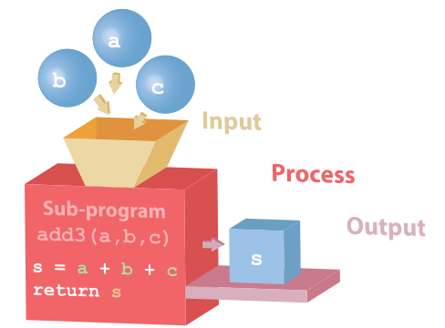
Defining Sub-programs
4.3
Apart from calling built-in functions, we can define our own functions.
For instance, we are going to design a sub-program to add three parameters together and return the sum. The following is the Input-Process-Output cycle of the sub-program:

Slide 15
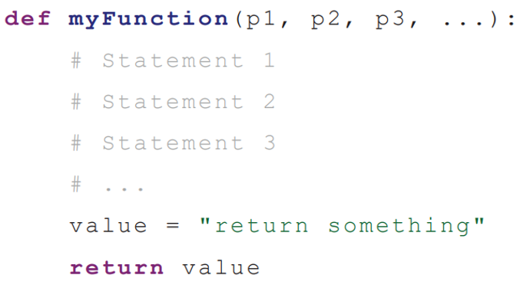
Syntax
A
Each sub-program or function represents multiple lines of code, and it must be defined before being called. In Python, we use the keyword def to define a sub-program:

Slide 16
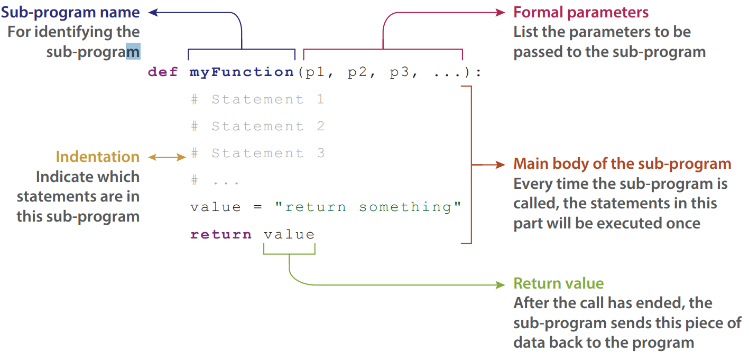
Syntax
A

Slide 17
Syntax
A
The name of a sub-program is its identifier. The rules for naming variables apply to naming sub-programs as well.
Every identifier in the same program:
Must be unique
No repetition is allowed

Slide 18
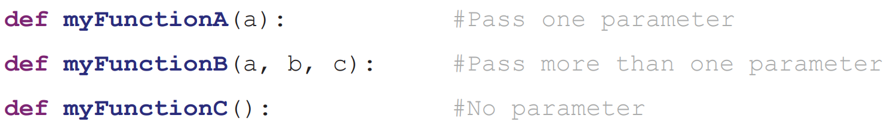
Syntax
A
The formal parameters to be passed to the sub-program are listed in the brackets.
The following are some examples:

Slide 19
Syntax
A
In a sub-program, the keyword return means ending the sub-program call and sending back the piece of data to the position where the sub-program is called. This piece of data is called the return value.

Slide 20
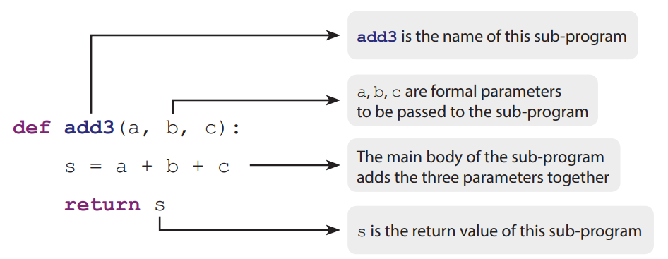
Syntax
A
Take the sub-program for adding three parameters together as an example, the following is the Python code for defining the sub-program:

Slide 21
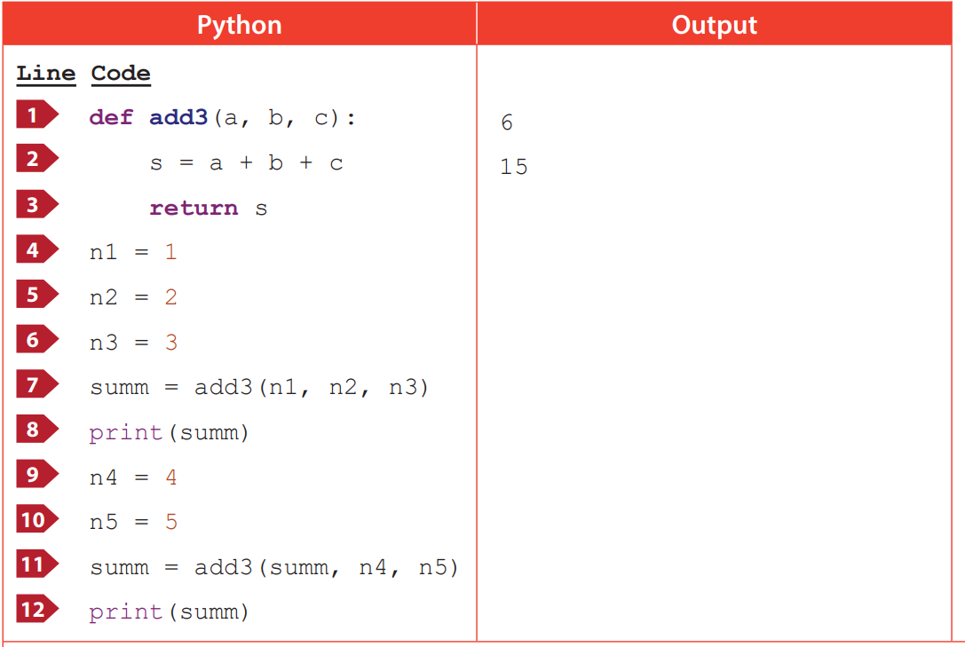
The sequence of calling a sub-program
B
After defining a sub-program, we can call it using its name, and call it repeatedly.

Slide 22
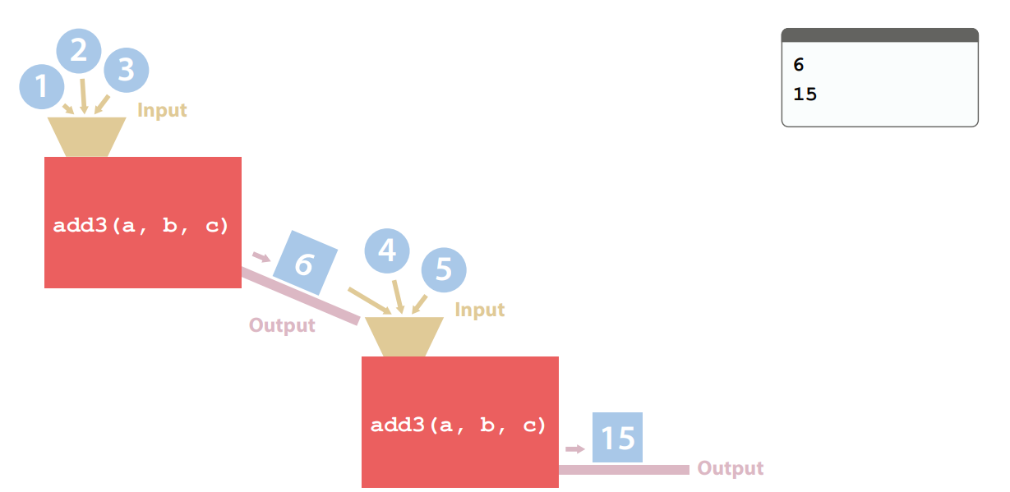
The sequence of calling a sub-program
B
The sequence of calling sub-programs:

Slide 23
4.1
Complete Activity 4.1 on P. 115 of your textbook
The sub-program must be defined before being called.

Slide 24
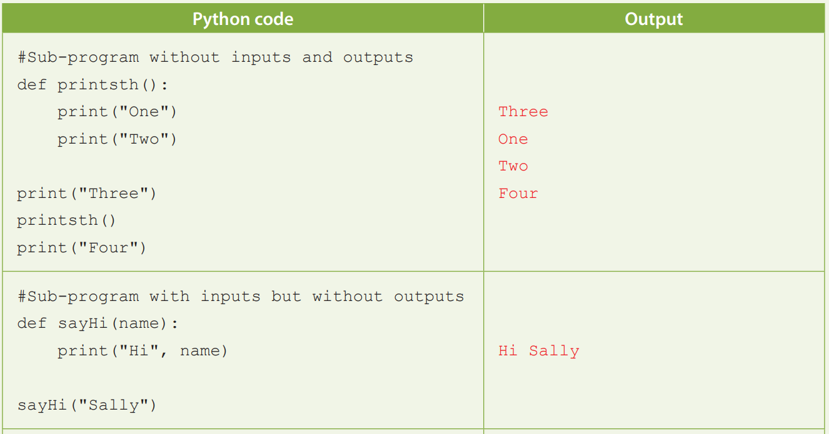
4.2
Complete Activity 4.2 on P. 116 of your textbook.

Slide 25
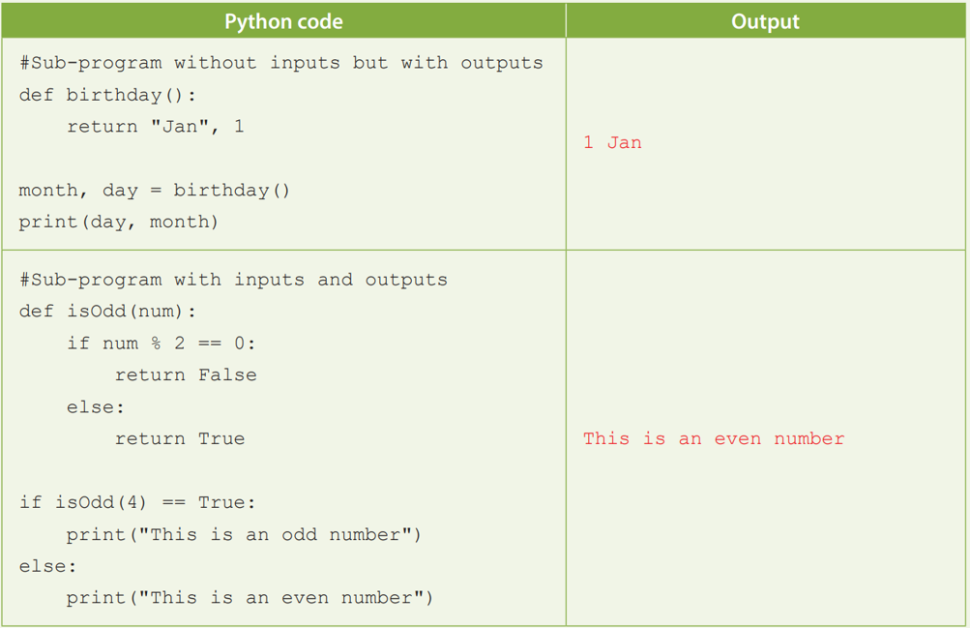
4.2

Slide 26
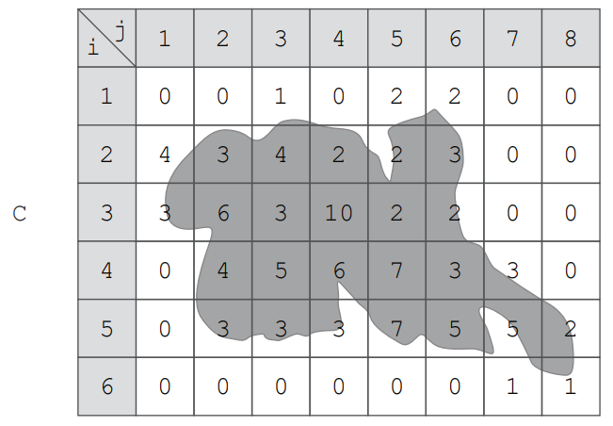
4.1
1. The following treasure map is divided into 6 × 8 cells. Chris defines a two-dimensional array C to store the number of gold coins in each position.
Chris writes a sub-program coins(i, j) to return the total number of gold coins in position C[i-1,j–1] to C[i+1,j+1].

Slide 27
4.1
(a) What is the return value for calling sub-program coins(5, 2)?
(b) (i) Which area has the most gold coins?
(ii) How many gold coins are there in this area?

Slide 28
4.1
(c) Complete the following pseudocode for the sub-program coins(i, j).
Sub-program coins(i, j) total ← 0 for x from 1 to _____ for y from 1 to _____ total ← total + C[ _____ , _____ ] return _____

Slide 29
4.1
(d) Chris finds that the program cannot function properly when he calls the sub-program coins(1, 7).
(i) Explain the cause of the above error.
(ii) Rewrite the nested loop body in the sub-program to solve this problem.

Slide 30
4.1
◣ Solution
(a) 15
(b) (i) coins(4, 4)
(ii) 46 (c) Sub-program coins(i, j) total ← 0 for x from 1 to 3 for y from 1 to 3 total ← total + C[i-2+x, j-2+y] return total

Slide 31
4.1
(d) (i) It is because the program reads items that are out of the range of the array index.
(ii) Nested loop body: if 1 <= (i-2+x) <= 6 AND 1 <= j-2+y <= 8 then total ← total + C[i-2+x, j-2+y]

Slide 32
4.2
Complete Checkpoint 4.2 on P. 120 of your textbook.
(a) for X from 1 to 10
for Y from X to 10
Add a block at (X, Y)
(b) Sub-program tri(n)
for X from 1 to n
for Y from 10-n+X to 10
Add a block at (X, Y)

Slide 33
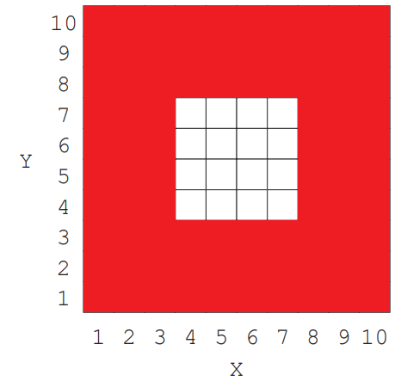
4.2
(c)
(d) Sub-program hole(t)
square(10)
for X from t+1 to 10-t
for Y from t+1 to 10-t
Remove a block at (X, Y)

Slide 34
4.2
(e) Input parameters 1, 2, 3, 4 Sizes of the empty spaces 8 × 8 × 1, 6 × 6 × 1, 4 × 4 × 1, 2 × 2 × 1
(f) A 3 × 3 × 3 cube at (1, 1, 1)
(g) for i from 1 to 10 tri(10) UP

Slide 35
4.2
(h) for i from 10 down to 1
tri(i)
UP

Slide 36
4.3
Complete Activity 4.3 on P. 124 of your textbook.
A variable that exceeds the scope is used.

Slide 37
Variable Scopes
4.4
In Python programs, each variable has a scope in which it can be used. Variables can be categorised into local variables and global variables according to the regions they cover

Slide 38
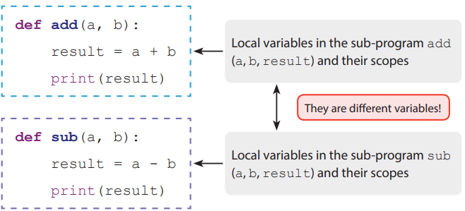
Local variables
A
A variable declared within a sub-program is regarded as a local variable. This variable is only valid within the sub-program. After the sub-program has ended, all local variables will be dropped.

Slide 39
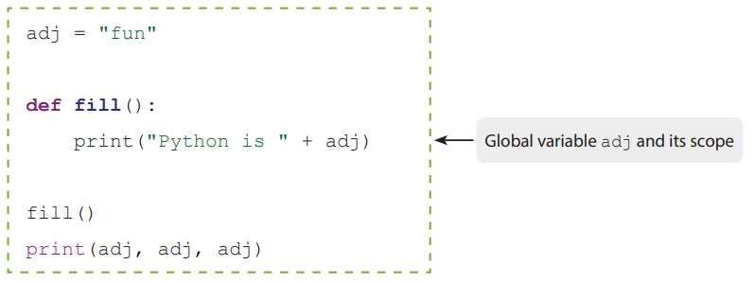
Global variables
B
A variable declared outside a sub-program is regarded as a global variable. Its scope covers the whole program including all sub-programs.

Slide 40
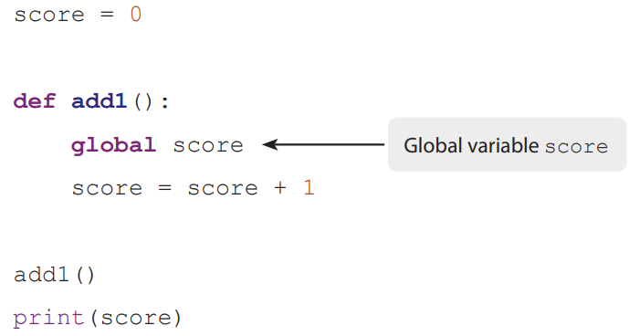
Global variables
B
To change the value of a global variable in the sub-program, we need to use the keyword global in the sub-program to represent the global variable.
Using the keyword global to refer to the global variable score

Slide 41
4.3
Complete Checkpoint 4.3 on P. 126 of your textbook.
(a) (i) def hasDigit(): for i in range(0, len(username)): if username[i] >= "0" and username[i] <= "9": return True return False
(ii) def noSpace(): for i in range(0, len(username)): if username[i] == " ": return False return True

Slide 42
4.3
(b) def checkExist():
for i in range(0, len(user)):
if username == user[i]:
return True
return False
(c) def checkUsername():
return hasDigit() and noSpace() and not(checkExist())

Slide 43
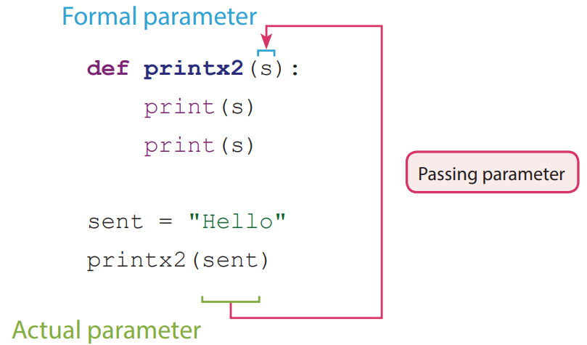
Parameters Passing
4.5
When calling a sub-program that requires an input parameter, the actual parameter will be passed to the formal parameter.

Slide 44
Passing immutable objects
A
In Python, integers (int), floats (float), Booleans (bool) and strings (str) are immutable objects.
When calling a sub-program and passing an immutable object, the value of the actual parameter will be copied to the formal parameter of the sub-program.

Slide 45
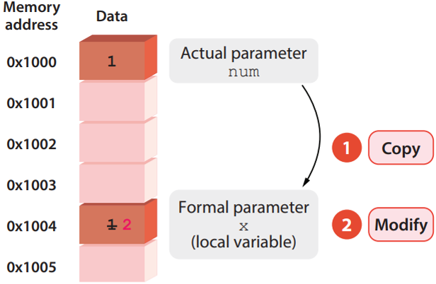
Passing immutable objects
A
Modifications made to the formal parameter within the sub-program do not affect the value in the actual parameter.

Slide 46
Passing mutable objects
B
Lists (list) are mutable objects in Python.
When calling a sub-program and passing a mutable object, the formal parameter of the sub-program will store the computer memory address of the actual parameter.
The formal parameter is the pointer of the actual parameter. When the sub-program is being run, the formal parameter will refer to the memory address of the actual parameter.

Slide 47
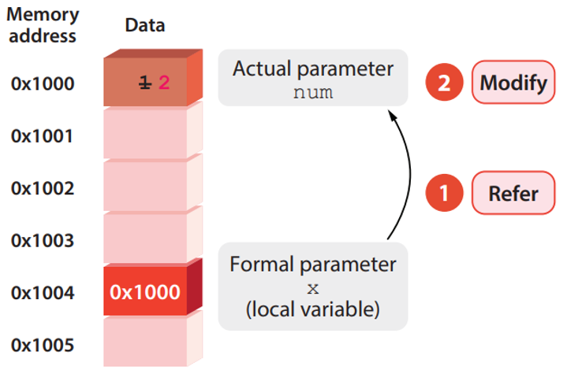
Passing mutable objects
B
Therefore, any modifications made to the formal parameter within the sub-program will be reflected in the actual parameter.

Slide 48
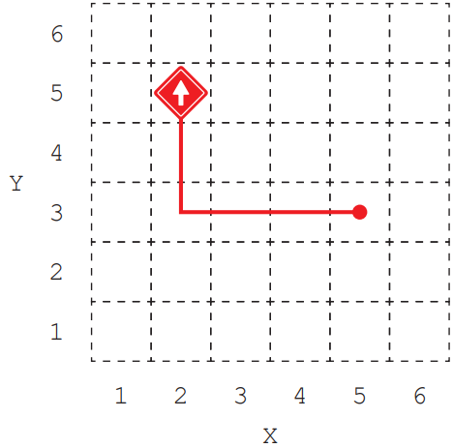
4.4
Complete Checkpoint 4.4 on P. 131 of your textbook.
(a)
(b) Sub-program TL
for i from 1 to 3
TR

Slide 49
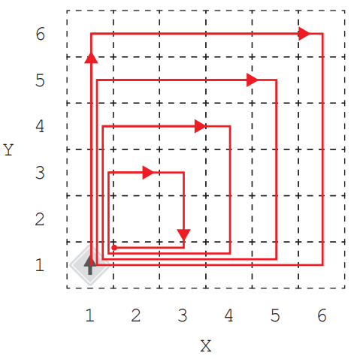
4.4
(c) Sub-program SQ(N) for i from 1 to 4 for j from 1 to N FW TR
(d)

Slide 50
4.4
(e) Sub-program MN for i from 1 to direction-1 TL FW
(f) Sub-program ME if direction > 2 then for i from 1 to direction-2 TL else if direction < 2 then for i from 1 to direction+2 TL FW
or direction+3

Slide 51
4.4
(h) Sub-program DIS() distance ← Square root of ((X-1)*(X-1) + (Y-1)*(Y-1)) return distance
(i) Sub-program GOTO(NX, NY) for i from 1 to |NX - X| if NX - X > 0 (or NX > X) then ME else MW for i from 1 to |NY - Y| if NY - Y > 0 (or NY > Y) then MN else MS

Slide 52
4.4
(j) GOTO(1, 1)
(k) for i from 1 to 5 goUP for i from 2 to 6 GOTO( i , i ) for i from 1 to 5 goDOWN for i from 5 down to 1 GOTO(i, i)

Slide 53
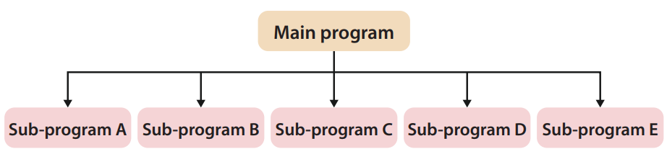
Stubs
4.6
Due to the benefits of modularisation, we often break down a complex program into multiple sub-programs.

Slide 54
Stubs
4.6
When our main program has many sub-programs, we may encounter the following two problems:
When we have not finished writing all the sub-programs, the whole program cannot function properly, or even cannot be compiled.
When an error occurs in the program, it is hard for us to determine which sub-program causes the problem.

Slide 55
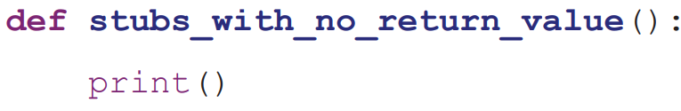
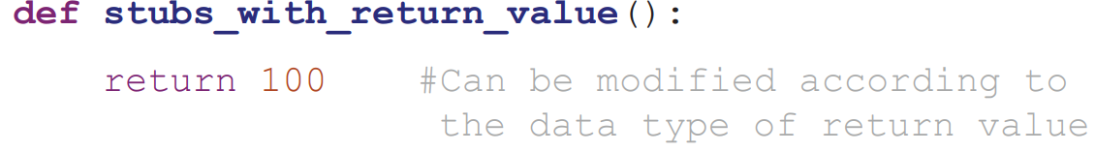
Stubs
4.6
Therefore, we need to use stubs.
They replace the main body of sub-programs by short, simple and temporary code, allowing the main program to run even when the sub-programs have not been completed.
Stubs without a return value:
Stubs with a return value:

